Slide 1
Maximum
Outreach via
MTA Data
Selin Berk, Julianne Zhao, & Vidisha Phalke

Slide 2
THE PROBLEM

Slide 3
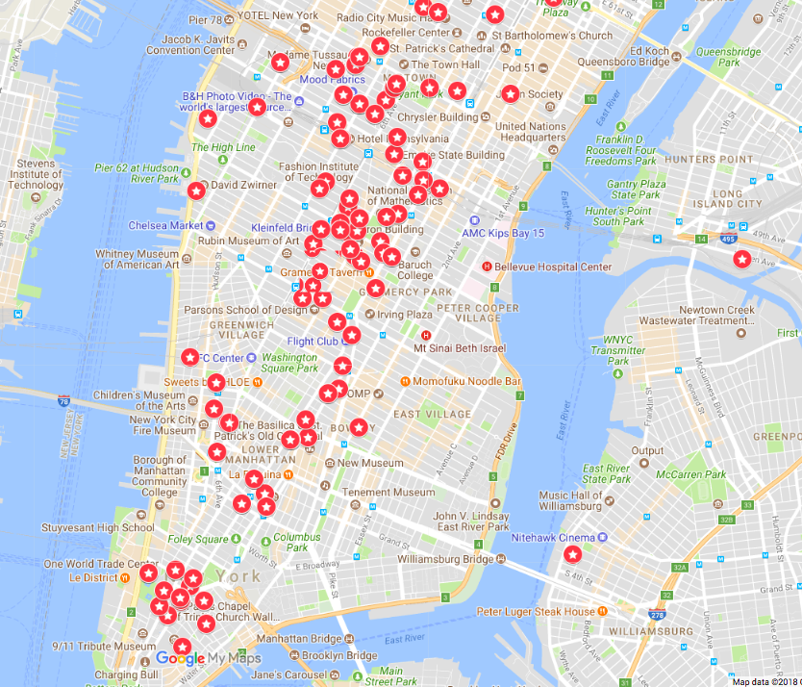
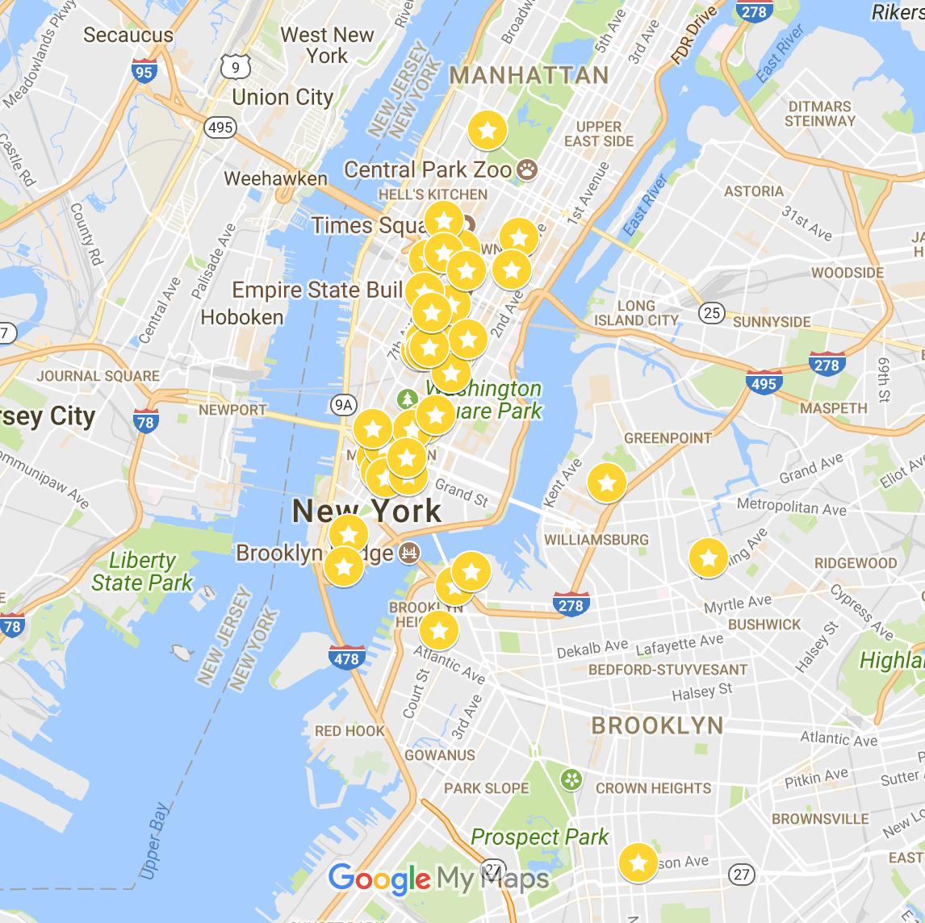
Established
VS
Startups

Slide 4
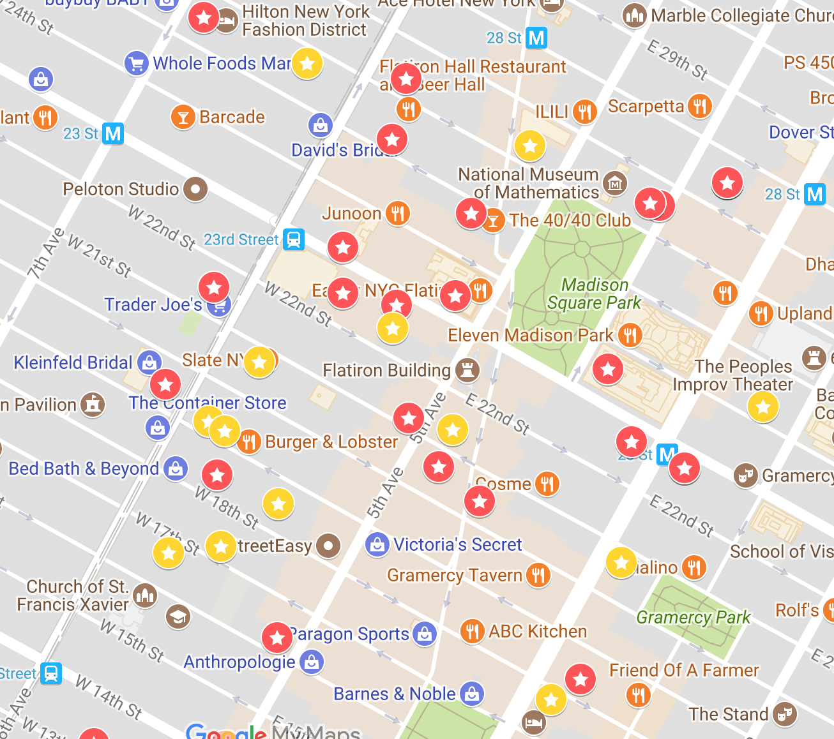
STATIONS
23rd St
28th St

Slide 5
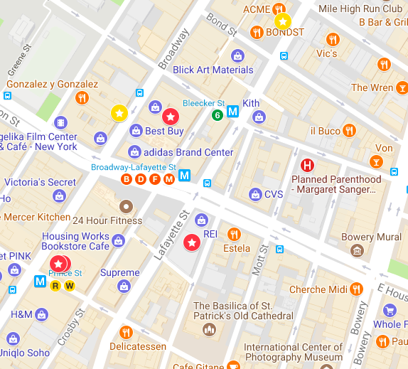
STATIONS
Canal St
Brd-Laf St
Bleecker St

Slide 6
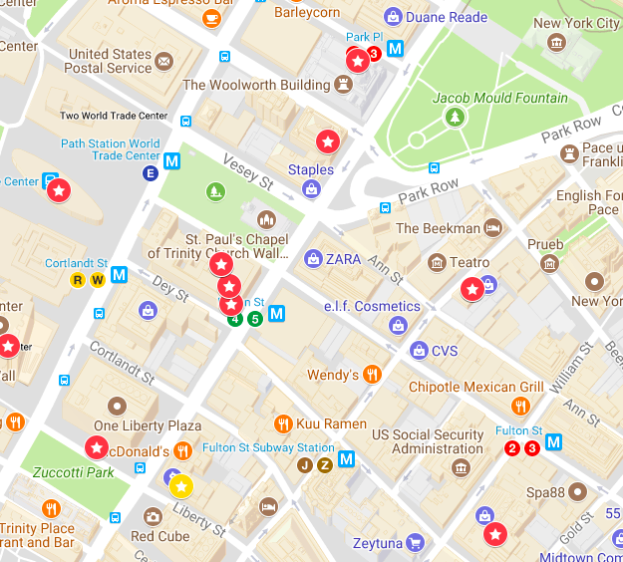
STATIONS
Cortland St
Fulton St
Park Place
World Trade

Slide 7
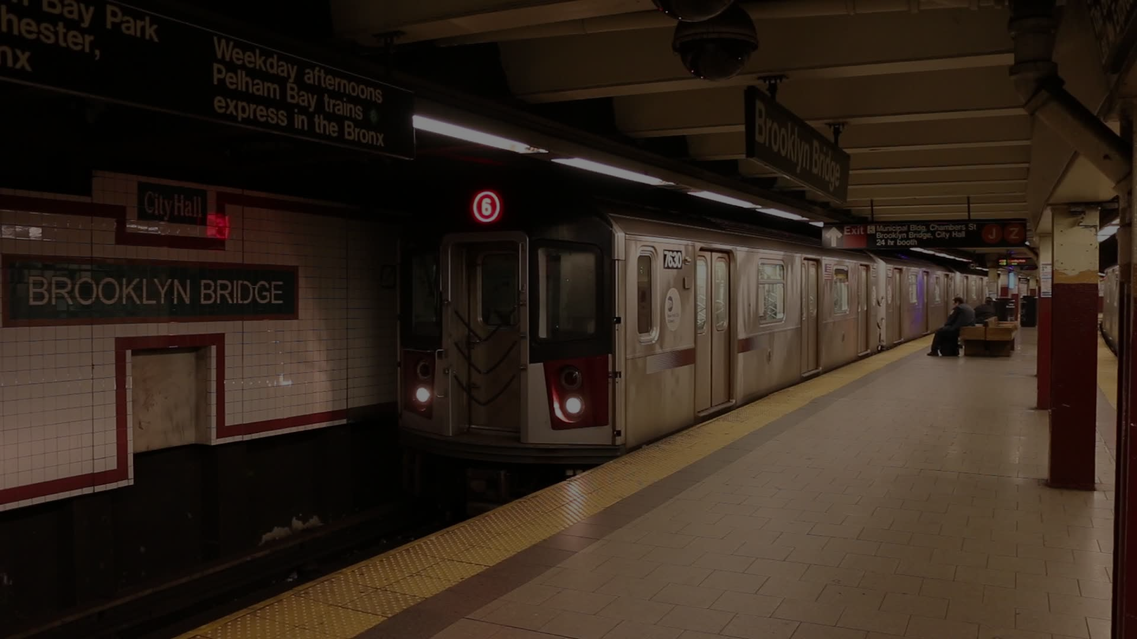
CONCLUSION

Slide 8
Works Cited
The New York City Subway in Manhattan. Youtube, 25 Oct. 2014,
www.youtube.com/watch?v=MlF5LaJkP68.
Warren, Liz. "Built In NYC's 50 Startups to Watch in 2018." Built in NYC, Built In, 16 Jan. 2018,
www.builtinnyc.com/2018/01/16/50-nyc-startups-watch-2018.
Warren, Liz. "Introducing NYC's Top 100 Tech Companies." Built in NYC, Built In, 7 Nov. 2017,
www.builtinnyc.com/2017/11/07/nyc-top-100-tech-companies-2017.

